Slide 1




A peer review process for higher reproducibility of publications in GIScience can also work for Earth System Sciences
Daniel Nüst¹
Frank O. Ostermann²
Carlos Granell³
¹ Technische Universität Dresden, Chair of Geoinformatics, Geosciences, Dresden, Germany (daniel.nuest@tu-dresden.de)
² Faculty of Geo-Information Science and Earth Observation (ITC), University of Twente, Enschede, The Netherlands (f.o.ostermann@utwente.nl)
³ Institute of New Imaging Technologies, Universitat Jaume I de Castellón, Castellón, Spain (carlos.granell@uji.es)
Please take pictures of the slides!
EGU 2023, Vienna
10.5194/egusphere-egu23-15384
https://bit.ly/peer-review-process-ess
Notes:
http://bit.ly/agile2021-repro-review

Slide 2
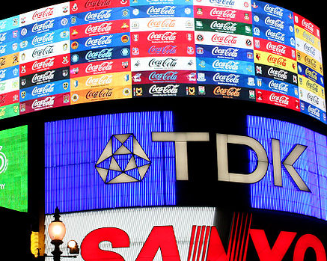
Claerbout’s claim:
An article about computational science in
a scientific publication is not the
scholarship itself, it is merely advertising
of the scholarship. The actual scholarship
is the complete software development
environment and the complete set of
instructions which generated the figures.
https://doi.org/10.1190/1.1822162
https://doi.org/10.1007/978-1-4612-2544-7_5
CC-BY 3.0, Sebastian Bertalan, Wikimedia Commons
Notes:
This is of course also the case for all AGILE and Earths System Sciene papers that use data and code.

Slide 3
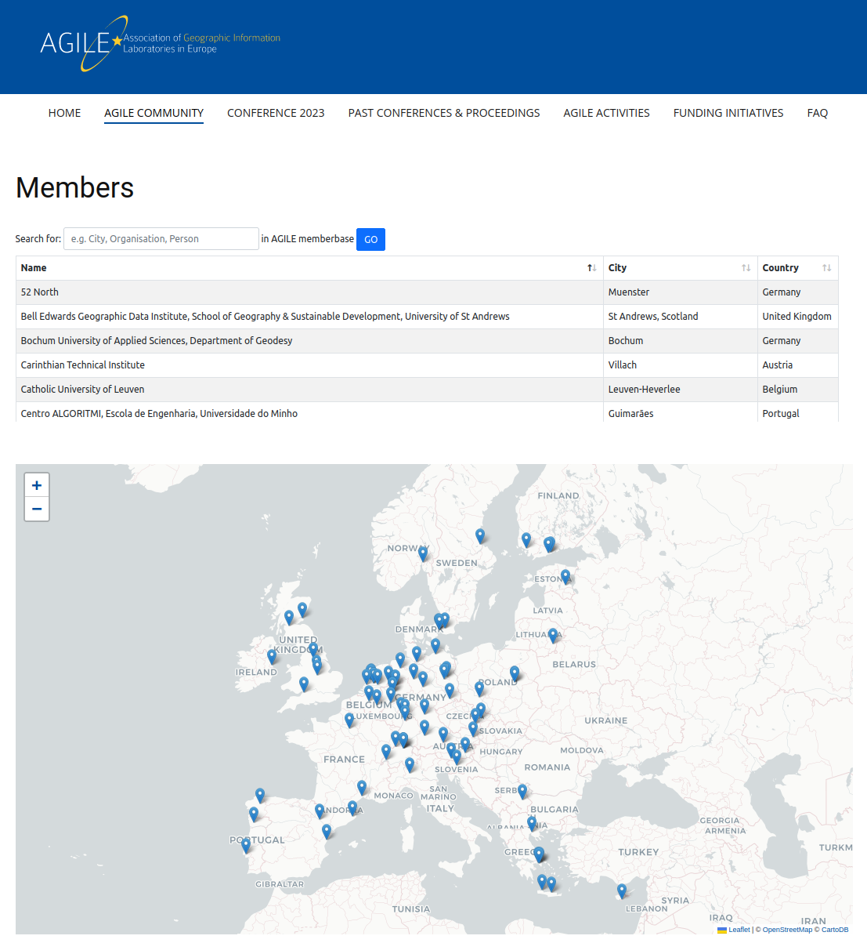
Who is AGILE?
https://agile-online.org/

Slide 4
https://reproducible-agile.github.io/
2017, ‘18 & ‘19: Workshops on reproducibility
2019: Reproducible publications at AGILE conferences
(AGILE Initiative supported by AGILE Council)
2020: First AGILE reproducibility review
2021: Second AGILE reproducibility review
2022: Third AGILE reproducibility review - guidelines mandatory
2023: Still going!
Notes:
Two workshops in 2017 and 2018 and a piece of meta-research into the reproducibility of papers published at the AGILE conference were the basis for a small group from the AGILE community to apply for an initiative to develop guidelines for reproducible publications. The AGILE council granted support for the initiative, and the guidelines were published shortly before the conference in 2019.
In 2020, the guidelines were for the first time recommended in the call for papers, and for the first time a reproducibility committee was put in place to evaluate the reproducibility of accepted papers. Find out more at the Reproducible AGILE website.
Today, I will introduce the Reproducible Paper Guidelines. Then, I’ll talk about the reproducibility review process at the last conference in detail and try to summarise the results and lessons learned in a way that makes them useful to other communities.

Slide 5
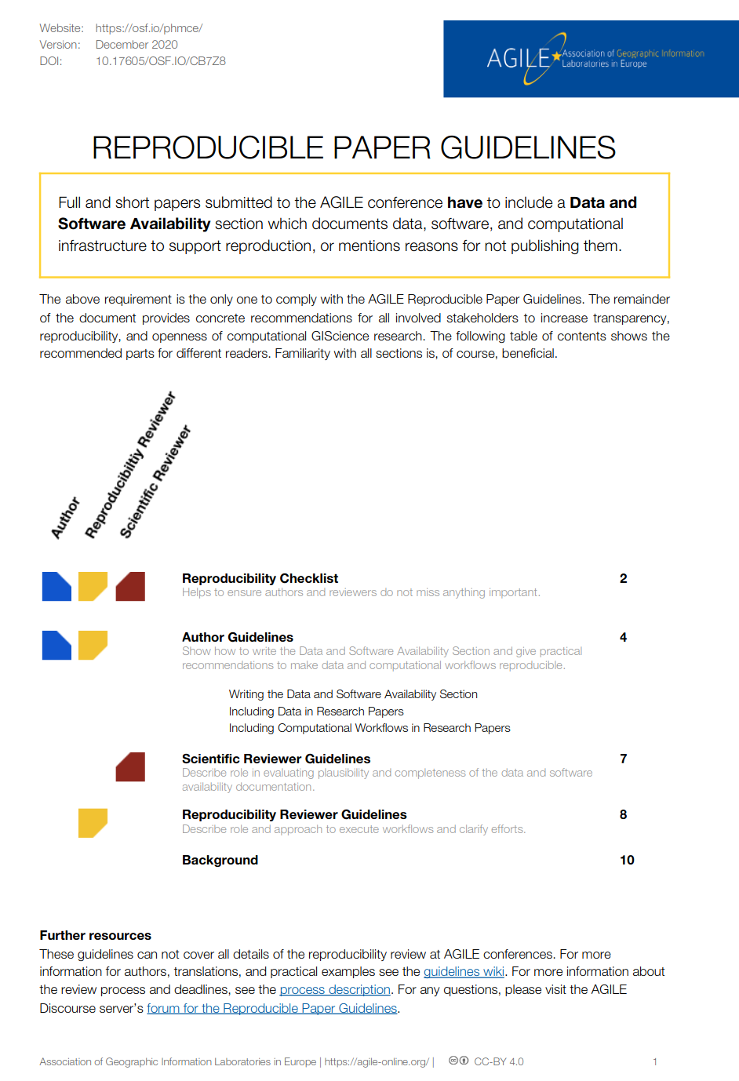
AGILE Reproducible Paper Guidelines 🇬🇧 🇪🇸 ^{(v1)} https://doi.org/10.17605/OSF.IO/CB7Z8
Created by AGILE Initiative in 2019 (see report at https://osf.io/hupxr/) and updated in 2020
Transparency over
enforcement
Promote, don’t exclude
Acknowledge spectrum and striving for ideal
Tailored to GIScience
Notes:
In 2019, AGILE supported an initiative for developing guidelines for reproducible papers.
These guidelines are the first compilation of tipps and tools how to increase transparency in GIScience papers, including a wiki with examples for typical GIScience datasets and workflows.
Their intention is to promote positive examples of reproducible computational research.
Primarily, the guidelines include AUTHOR GUIDELINES, that is how to incorporate DATA and COMPUTATIONAL ​ WORKFLOWS​ IN RESEARCH PAPERS and a section on WRITING THE DATA AND SOFTWARE AVAILABILITY SECTION, or “DASA” section.
Having a DASA section is the only mandatory requirement! It is absolutely possible not to provide any links to data and code and comply with the guidelines at the same time.
These guidelines were put into the call for papers as a recommendation.

Slide 6
The guidelines
https://doi.org/10.17605/OSF.IO/CB7Z8
Reproducibility checklist
Author guidelines
Writing DASA section
Data in Research Papers
Computational workflows in Research Papers
Reviewer guidelines
Reproducibility reviewer guidelines
Background
Notes:
These are the contents of the guidelines: Primarily, they include AUTHOR GUIDELINES. These give advice how to incorporate DATA and COMPUTATIONAL ​WORKFLOWS​ IN RESEARCH PAPERS, and how to WRITE THE DATA AND SOFTWARE AVAILABILITY SECTION section. There also is a pre-submission checklist for authors.
The document also includes some background on the rationale and motivation, as well as reviewer guidelines and, brand new in the current draft, reproducibility reviewer guidelines.

Slide 7
Thanks!
To the contributors to the AGILE Reproducible Paper Guidelines
Daniel Nüst
Frank Ostermann
Rusne Sileryte
Barbara Hofer
Carlos Granell
Marta Teperek
Anita Graser
Karl Broman
Kristina Hettne
Connie Clare
Frederique Belliard
Yan Wang
https://giphy.com/gifs/HBOMax-Pnh0Lou03fv92J4puZ
Notes:
Many experts that are not part of the AGILE community - we owe them a great thank you for helping us to get better.

Slide 8
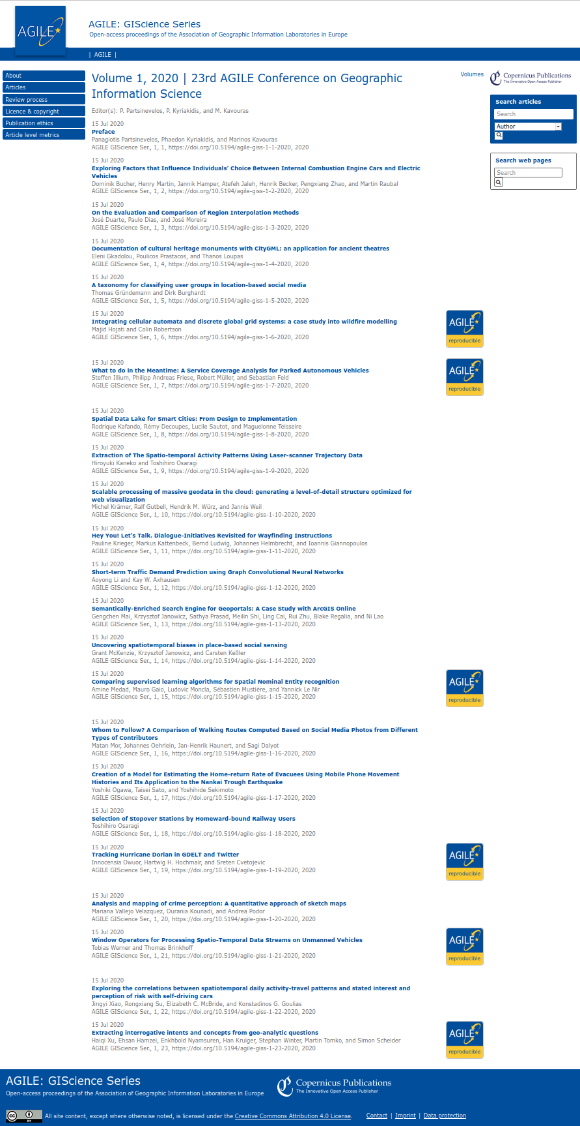

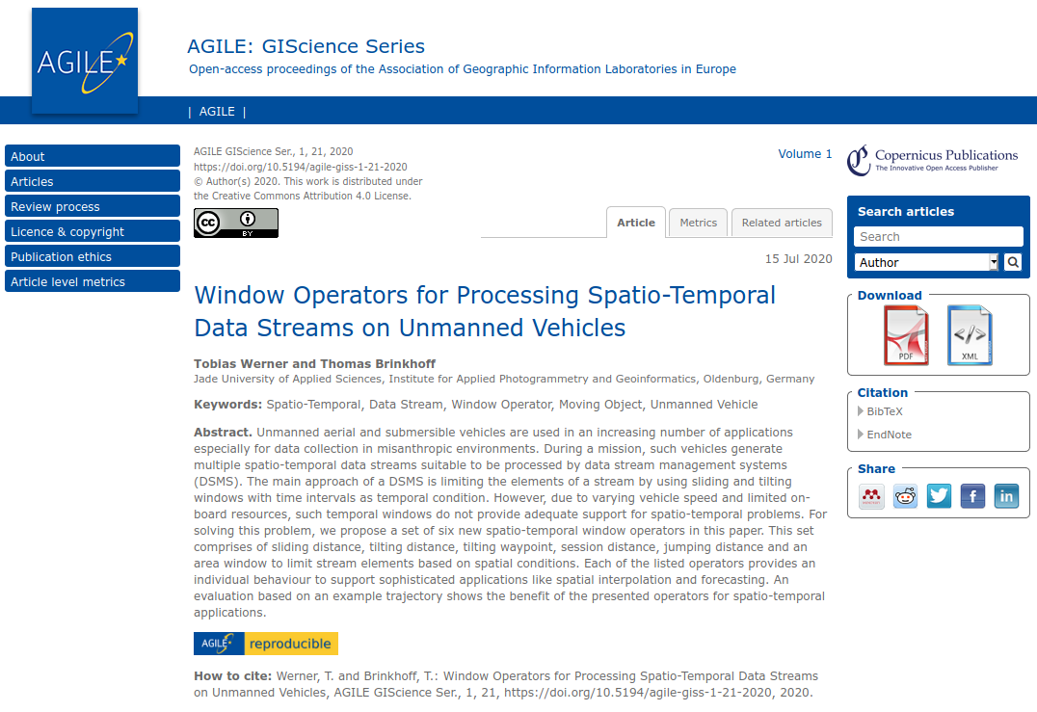

Review process
Proceedings: agile-giscince-series.net/review_process.html
Process documentation: osf.io/7rjpe/
Reproducibility review of full papers after accept/reject decisions by scientific reviewers
Reproducibility review & communication
Community conference & volunteers
Badges on proceedings website and article title page link to reproducibility reports (Thanks Copernicus!)
Notes:
First a few words about the process. You can find the details in the linked document.
Let’s start with the order: the reproducibility review happened after the authors were notified about the acceptance or rejection. Ideally, we wanted to review only papers that were identified by the scientific reviewers, but we found that that was not reliable so we briefly checked all papers ourselves. Also, none of the regular reviewers could be intrigued to attempt a reproduction.
This reduced the number of papers and allowed us to communicate directly with the authors during the reproducibility reviews.
The process was not smooth, because AGILE is a community-led conference managed by volunteers, and the authors are the ones who prepare the camera-ready copies of the articles. So there is a lot of moving parts with no central control. On top of that, the conference switched the publisher and the Coronavirus destroyed all schedules.
Eventually, the papers were published. The publisher added badges on the landing pages of the proceedings, which link to the reproducibility reports, as you can see on the right hand side. The papers themselves do not reference the reports.
We originally planned to have short presentations of selected reproducible papers in the final conference session, where candidates for the the best paper award are presented and voted live by the audience. Unfortunately, the in-person event was cancelled, so we could not have a showcase of the first batch of reproducible papers as we would have liked to.

Slide 9

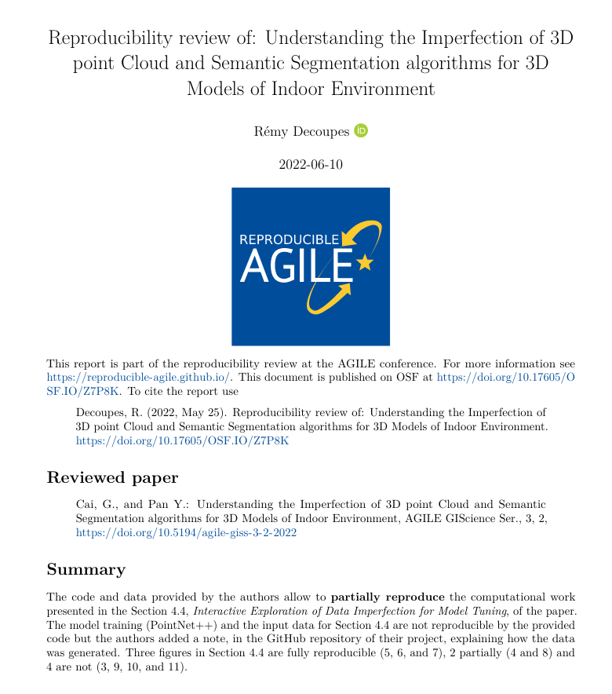
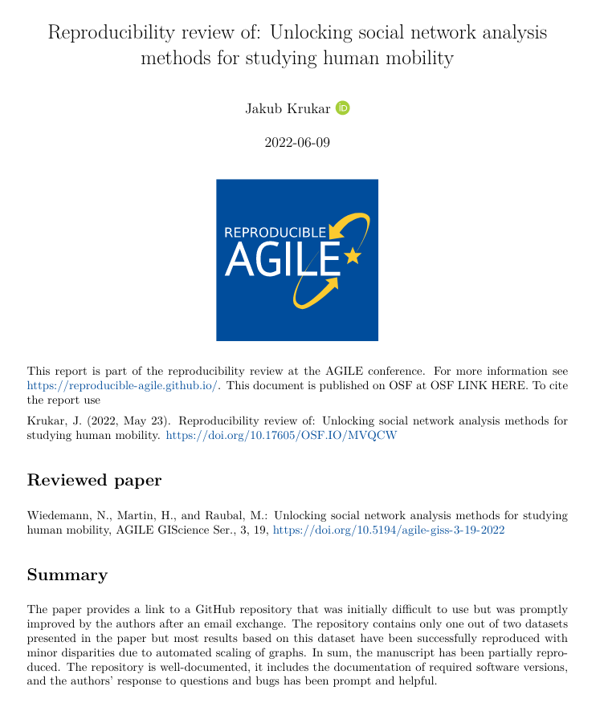
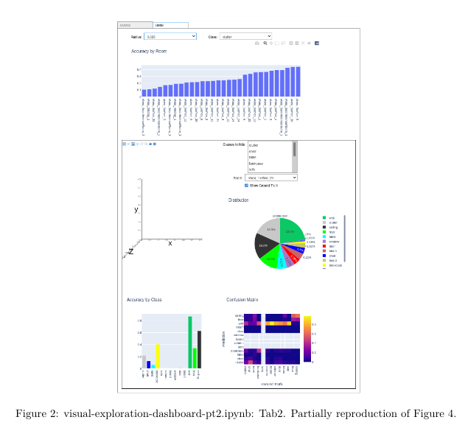
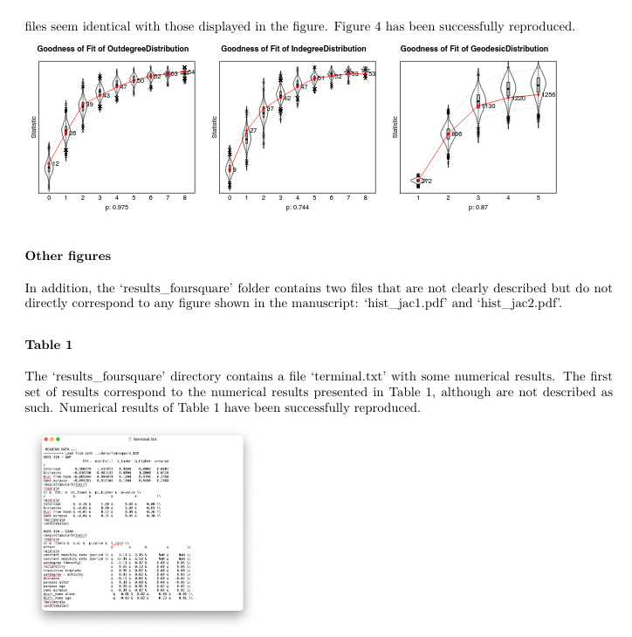
Example reproducibility reviews from AGILE 2022
https://doi.org/10.17605/OSF.IO/Z7P8K
https://doi.org/10.17605/OSF.IO/MVQCW
Notes:
Left: This paper is an outstanding example not because it was fully reproducible, but because, the reviewing process contributed to help the authors to adopt better scientific practices: They added a citation to the original paper that described the tool they used, they added a license to their project, they improve theirs instructions to install the computational environment, and they explained the non reproducible parts of their pipeline in their GitHub repository.
Right: In a similar vein, this paper started as some code lying around at some repo without a README. In response to the reproducibility reviewer’s questions over email, the authors: prepared a pretty README, fixed a few bugs that prevented running the code, and identified a bug in their original manuscript (where an axis in a graph was labelled incorrectly) and corrected the manuscript before publication.

Slide 10

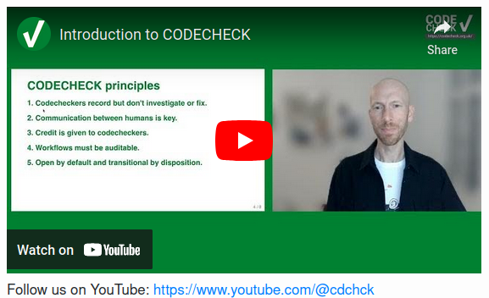
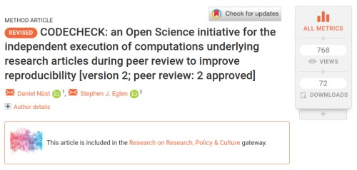
Independent execution of computations underlying research articles.
Principles
Codecheckers record but don’t investigate or fix.
Communication between humans is key.
Credit is given to codecheckers.
Workflows must be auditable.
Open by default and transitional by disposition.
Notes:
This review process is an implementation of the CODECHECK principles.

Slide 11
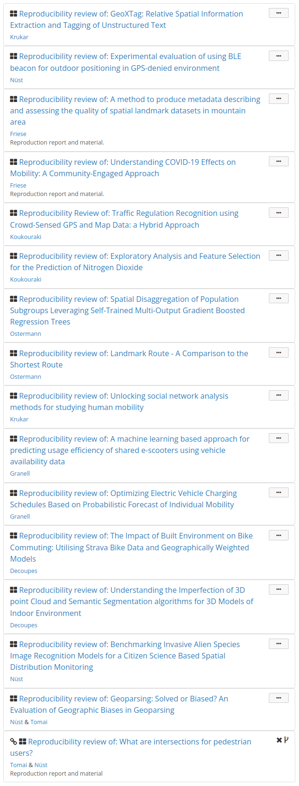
Reproducibility review results
2022: 16 reproducibility reports published
= 73% of accepted full papers
2021: 9 2020: 6
2018-19:? ..-2017: 0?! (see 10.7717/peerj.5072)
📈📈📈
6 not reproducible:
authors say too difficult / too busy
no data nor code (tutorial, conceptual)
big data + prop. tool & code not working
https://osf.io/r5w79/
Notes:
Reproducibility Reports are published on OSF and citable with a DOI.

Slide 12
Thanks!
To all reproducibility reviewers
Alexander Kmoch
Anita Graser
Arun Sharma
Carlos Granell
Daniel Nüst
Eftychia Koukouraki
Eleni Tomai
Frank Ostermann
Jakub Krukar
Philipp Friese
Rémy Decoupes
Nina Wiedemann
Mehtab Alam Syed
https://codecheck.org.uk/register/
https://giphy.com/gifs/HBOMax-Pnh0Lou03fv92J4puZ
Notes:
Many experts that are not part of the AGILE community - we owe them a great thank you for helping us to get better.

Slide 13
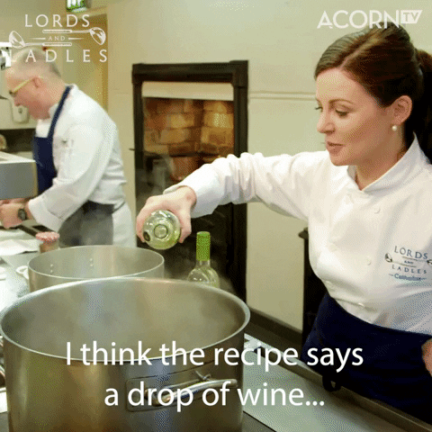
From AGILE to ESS
Four ideas that are transferable to Earth System Sciences:
human-centered process, communicative focus, supportive framework of tools and infrastructure, and candidates.
https://giphy.com/gifs/acorn-tv-wine-cooking-recipe-BhsSZR0k6EMxjCQDwP
Notes:
https://giphy.com/gifs/cbc-funny-comedy-xT9IgzFnSqzt2Sp3EI

Slide 14
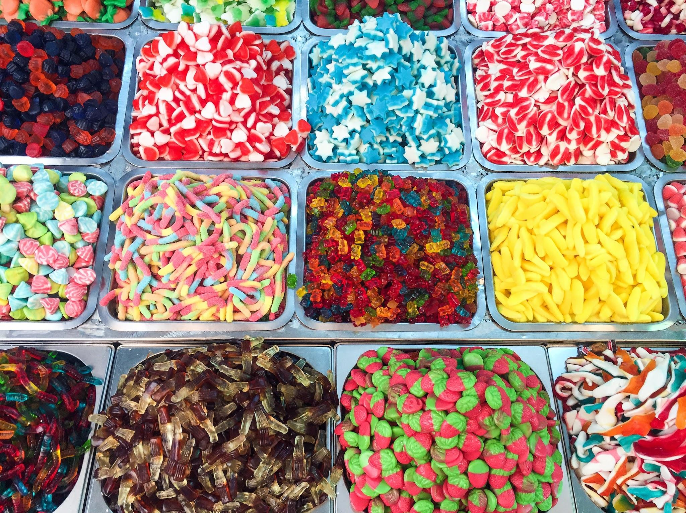
‏‏‎ ‎Human-centered process for ESS‏‏‎ ‎
‏‎‎reproducibility handles variety‎‏‏‎ ‎
Author provides material and makes fixes
Collaborate to make things work
Codechecker stops when confident enough all parts are provided and then gives review
… by transferring the challenge to codechecker matching?
Photo JACQUELINE BRANDWAYN | Unsplash
Notes:
First, Reproducible AGILE’s human-centered process is able to handle the increasingly complex, large and varying data-based workflows in ESS because of the clear guidance on responsibilities
What should the author provide?
How far does the reproducibility reviewer need to go?
Large data? Bespoke script? Latest tool version? Niche compiler?

Slide 15
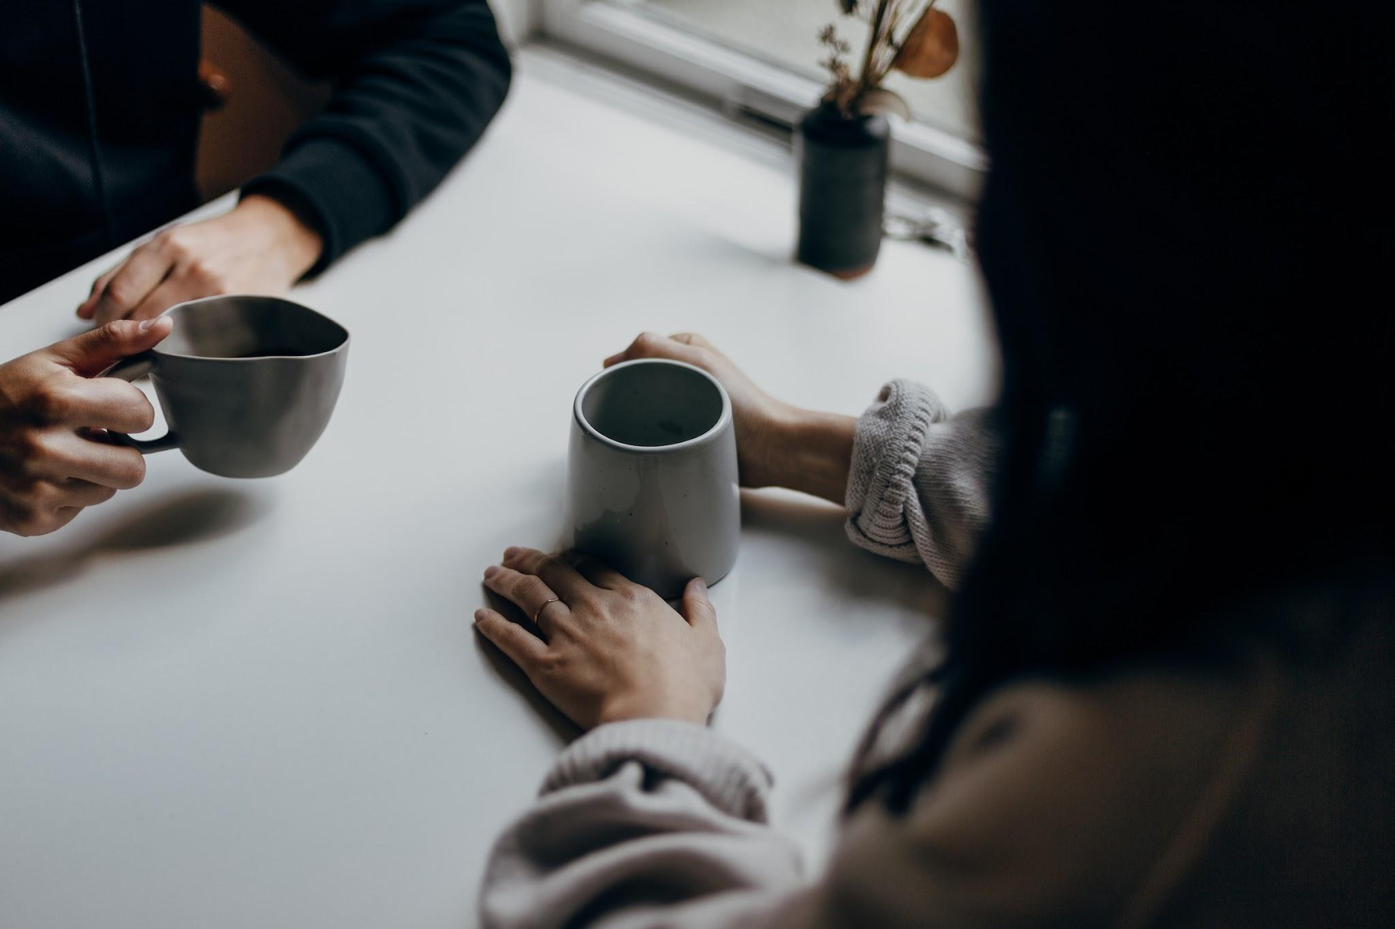
‎Communicative focus for ESS reproducibility.
Avoids rules & automation playing catch with innovation & technology
Avoids unification or limitation of researcher freedom
Continuous development of shared practice over time
& definition of “reproducibility” and “how reproducible is enough"
Targets attitudes towards sharing, transparency, and openness
Positive learning experience for all involved roles
Photo by Priscilla Du Preez | Unsplash
Notes:
Second, the communicative focus of the process is very well suited to, over time, help to establish a shared practice based on current technical developments, such as FAIR Digital Objects, and to reform attitudes towards openness, transparency and sharing. A code execution following the CODECHECK principles is a learning experience that may sustainably change researcher behaviours and practice. At the same time, Reproducible AGILE’s approach avoids playing catch-up with technology and does not limit researcher freedom or includes a need to unitise researcher workflows beyond providing instructions suitable for a human evaluator, similar to academic peer review.

Slide 16
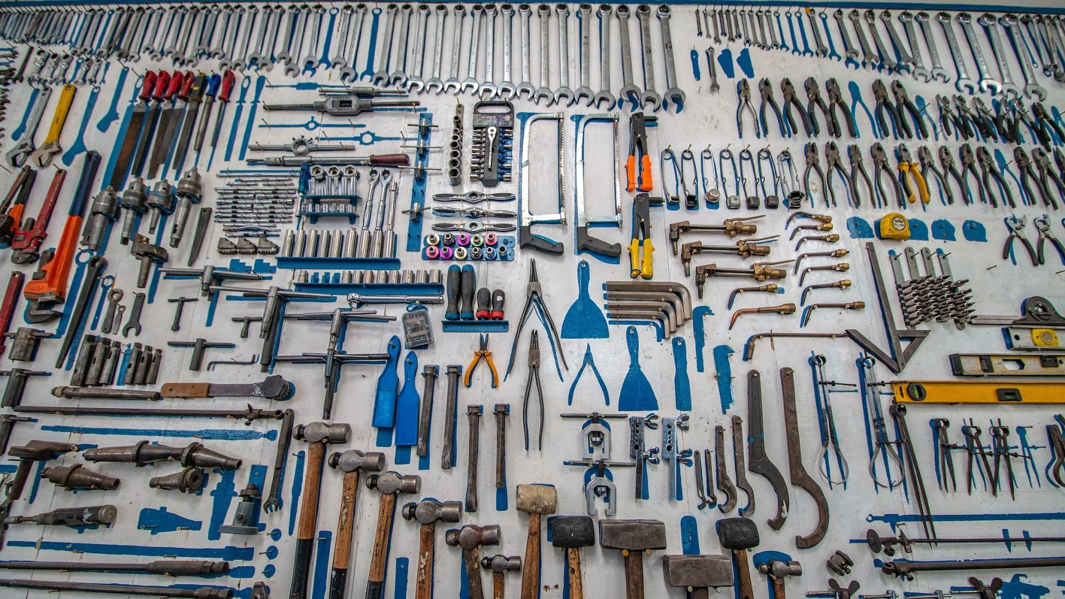
Tools & infrastructure for ESS reproducibility.
Faster codechecking with…
Notebooks
Binder (BinderHub)
Open methods
Missing?!
- free Binder-ready notebooks close to the data
- metadata connectivity > credit & partial re-building
- (small) reference datasets & demo pipelines
Photo by Cesar Carlevarino Aragon | Unsplash
Notes:
Third, while being agnostic of technology and infrastructures, a supportive framework of tools and infrastructure can of course increase the efficiency of conducting a code execution. We outline how existing infrastructures may serve this need and what is still missing.

Slide 17
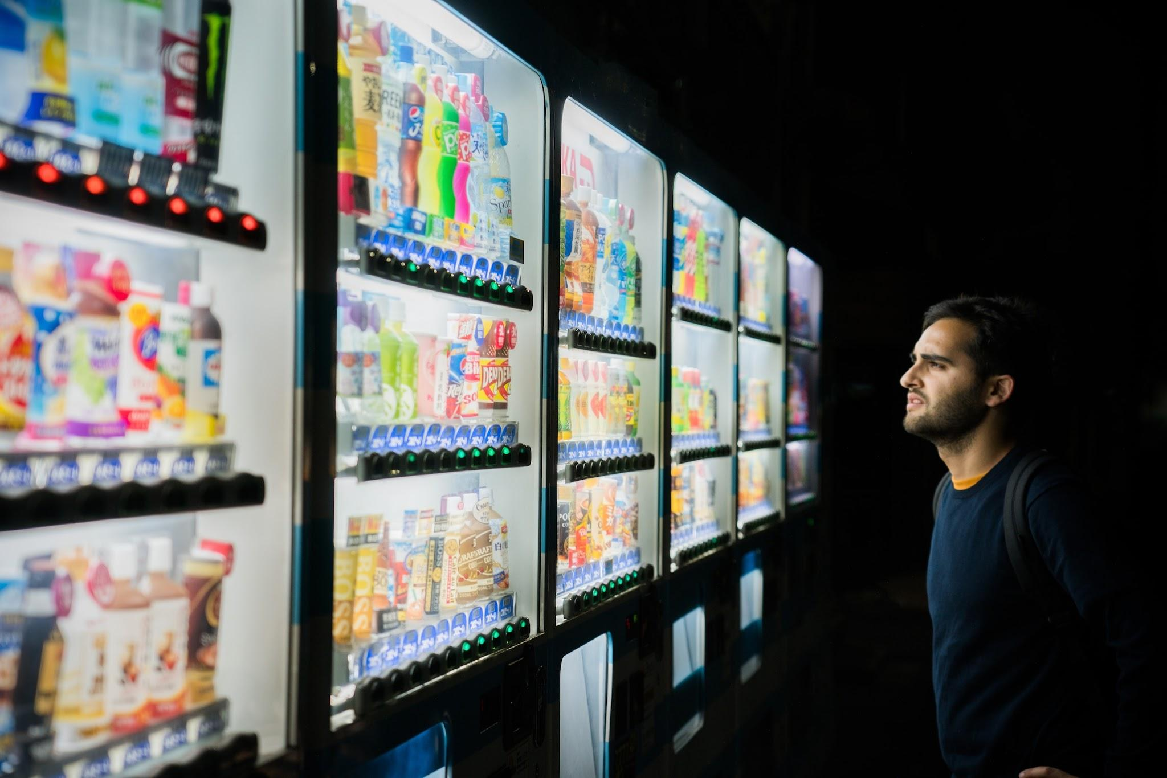

Candidates for ESS reproducibility
Earth System Science Data (ESSD)
All EGU/Copernicus.org/AGU journals?
ES³
???
Photo Victoriano Izquierdo | Unsplash
Notes:
[..]
YOU TELL ME! I’d be interested to make it happen together with you!
Fourth, we list potential candidates of event series or journals that could introduce a code checking procedure because of their organisational setup or steps towards more open scholarhip that were already taken.
Alternative image: https://unsplash.com/photos/C7B-ExXpOIE

Slide 18
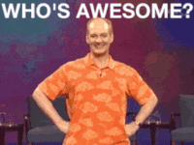
https://media.giphy.com/media/mbhseRYedlG5W/giphy.gif
What are the steps that you could take? Five year plan:
1️⃣ Initiate discourse with a core team in a
(small, sub) community (e.g., small event, journal)
2️⃣ Document state of reproducibility &
find leadership support
3️⃣ Establish guidelines (do-ocracy) &
apply to current work (preprints?)
4️⃣ Continue development and positive discourse
5️⃣ Give talk about experiences and share
Notes:
Build a team of enthusiasts (workshop, social events)
Assess the current state and raise awareness (workshop, paper)
Institutional support (🙏 AGILE Council 🙏 + committee chairs)
Positive encouragement (no reproduction != bad science)
Keep at it!

Slide 19


Thank you!
Questions?
@nordhomen | daniel.nuest@tu-dresden.de
Nüst, D., Ostermann, F. O., and Granell, C.: A peer review process for higher reproducibility of publications in GIScience can also work for Earth System Sciences, EGU General Assembly 2023, Vienna, Austria, 24–28 Apr 2023, EGU23-15384, https://doi.org/10.5194/egusphere-egu23-15384, 2023.
Slides published under CC BY 4.0
Notes:
Quick summary: we learned that papers are only the advertising of research and that the Reproducible AGILE initiative is advancing the GIScience discipline by implementing the ODECHECK principles for a reproducibility review in a community conference. The applied approach focuses on human interaction and communiciation which allows to handle variety of research and makes reproductions an educational motivating collaborative learning experience. Technology and tools are not the issue, but they can reduce friction. The presented approach can be transferred to your favourite ESS journal or event - and you are the one to do it.
https://www.publicdomainpictures.net/en/view-image.php?image=118583&picture=&jazyk=FR

Slide 21
Abstract
The Reproducible AGILE initiative (https://reproducible-agile.github.io/) successfully established a code execution procedure following the CODECHECK principles (https://doi.org/10.12688/f1000research.51738.2) at the AGILE conference series (https://agile-online.org/conference). The AGILE conference is a medium-sized community-led conference in the domains of Geographic Information Science (GIScience), geoinformatics, and related fields. The conference is organised under the umbrella of the Association of Geographic Information Laboratories in Europe (AGILE).
Starting with a series of workshops on reproducibility from 2017 to 2019, a group of Open Science enthusiasts with the support of the AGILE Council (https://agile-online.org/agile-actions/current-initiatives/reproducible-publications-at-agile-conferences) was able to introduce guidelines for sharing reproducible workflows (https://doi.org/10.17605/OSF.IO/CB7Z8) and establish a reproducibility committee that conducts code executions for all accepted full papers.
In this presentation, we provide details of the taken steps and the encountered obstacles towards the current state. We revisit the process and abstract a series of actions that similar events or even journals may take to introduce a shift towards higher reproducibility of research publications in a specific community of practice.
We discuss the taken approach in the light of the challenges for reproducibility in Earth System Sciences (ESS) around four main ideas.
First, Reproducible AGILE’s human-centered process is able to handle the increasingly complex, large and varying data-based workflows in ESS because of the clear guidance on responsibilities (What should the author provide? How far does the reproducibility reviewer need to go?).
Second, the communicative focus of the process is very well suited to, over time, help to establish a shared practice based on current technical developments, such as FAIR Digital Objects, and to reform attitudes towards openness, transparency and sharing. A code execution following the CODECHECK principles is a learning experience that may sustainably change researcher behaviours and practice. At the same time, Reproducible AGILE’s approach avoids playing catch-up with technology and does not limit researcher freedom or includes a need to unitise researcher workflows beyond providing instructions suitable for a human evaluator, similar to academic peer review.
Third, while being agnostic of technology and infrastructures, a supportive framework of tools and infrastructure can of course increase the efficiency of conducting a code execution. We outline how existing infrastructures may serve this need and what is still missing.
Fourth, we list potential candidates of event series or journals that could introduce a code checking procedure because of their organisational setup or steps towards more open scholarship that were already taken.
How to cite: Nüst, D., Ostermann, F. O., and Granell, C.: A peer review process for higher reproducibility of publications in GIScience can also work for Earth System Sciences, EGU General Assembly 2023, Vienna, Austria, 24–28 Apr 2023, EGU23-15384, https://doi.org/10.5194/egusphere-egu23-15384, 2023.

Slide 22
Next steps
Do it again in 2023 🎉
… and for real?
Reject irreproducible papers?
Fix reproducibility review vs. schedule
🛠️ Revise guidelines? 🇮🇹 🇫🇷 🇨🇳
Grow reproducibility reviewer team (= YOU!)
Longitudinal meta-research study
Towards opening scholarship
Format-free first submission
Review/Publish computational notebooks
Require CRediT
Reviewer activity @ ORCID
Open review (if tenured?)
Discourse on peer review (read this)
Notes:
I’d like finish with a short outlook on the next steps.
Most importantly, we are doing it again next year and try to learn from our experiences.
Furthermore, the guidelines will be improved. Most likely we will simplify them and move details to other places. I’m keen on having the guidelines translated to make them more accessible, and hope they find adoption beyond the conference.
We need to grow reproducibility reviewer team, which I think is a great opportunity to involve early career researchers in peer review. More people means more diverse skill sets to better match the given manuscripts.
I hope that we will be able to give reproducibility (and regular) reviewers public credit soon, for example by putting reviewer activity into ORCID profiles.
We continue to research the state of reproducibility in GIScience and have just published a preprint on another conference series, the GIScience conference. The results are equally sobering as for the AGILE conference three years ago.
And, of course, the continued interaction with the community is key to increase reproducibility further. We will debate the scope of the review and when to increase requirements, maybe even require reproductions for acceptance?
In the long term, I personally hope the awareness on reproducibility is a starting point for more open practices in general, for example requiring tenured reviewers to disclose their identity, accept first submissions without formatting, or using the CRediT taxonomy for author contributions.
And most importantly, I’d be completely fine to phase out the special reproducibility review, when reproducible papers have become standard practice.

Slide 23
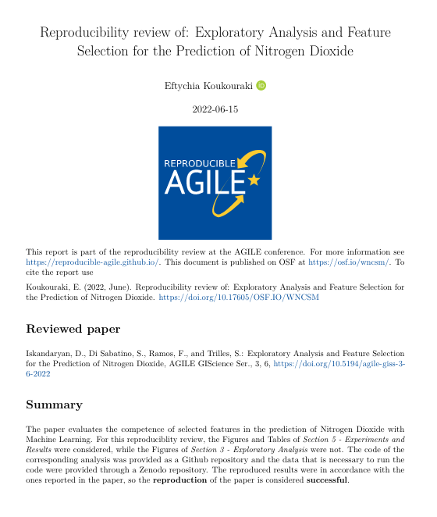
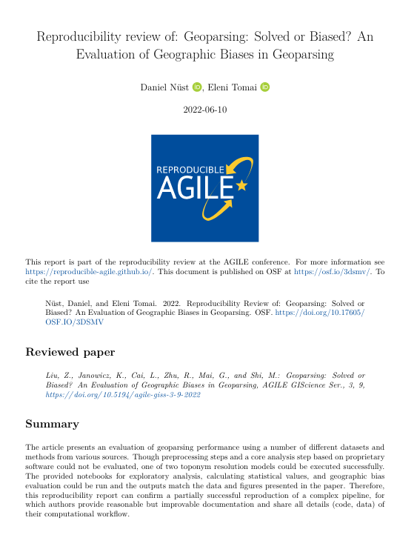
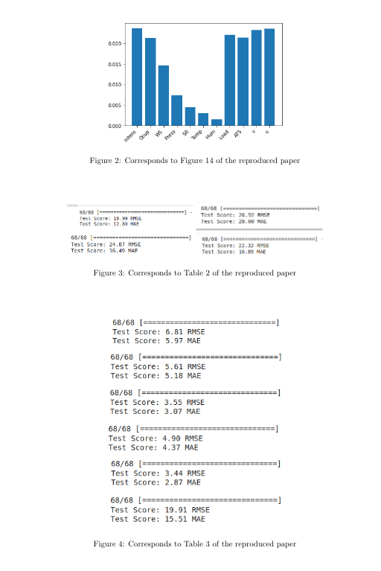
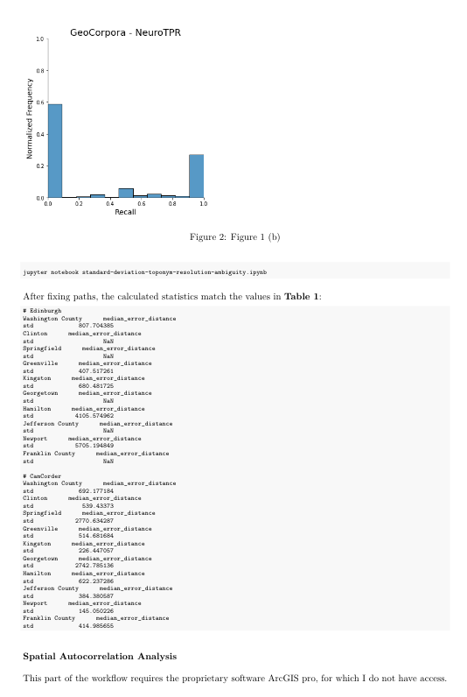
Example reproducibility review reports from AGILE 2022
https://doi.org/10.17605/OSF.IO/W7VPH
https://doi.org/10.17605/OSF.IO/3DSMV
Notes:
Left: Thanks to the conversation with the reproducibility reviewer, authors eventually created a more organized version of their workflow in their GitHub repository. At the beginning their code was not runnable for someone else, and in the end they even provided their trained models on top of the code for the actual training. So it was a learning process for the authors as well, and possibly more for the community: Including the trained models as a kind of pre-processed data component in Machine Learning studies maybe something to consider for future requirements.
Right: This final example shows the limitations of the reproducibility review process, but also that it is worth checking as much as we can! The article partly uses proprietary GIS software for preprocessing and analysis, which could not be checked, but also shares computational notebooks for visualisation and parts of the process could be successfully run.

Slide 24
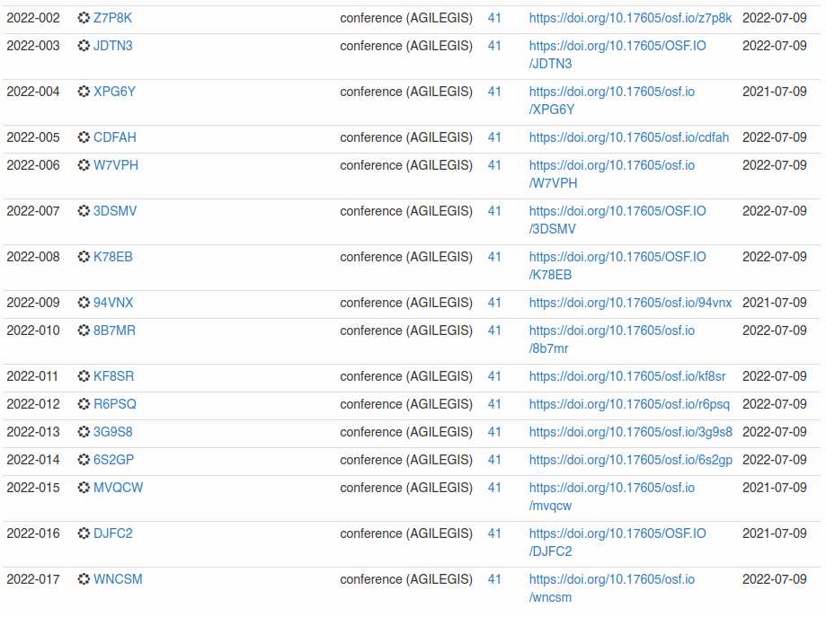
Collaboration with
https://codecheck.org.uk/register/

Slide 25
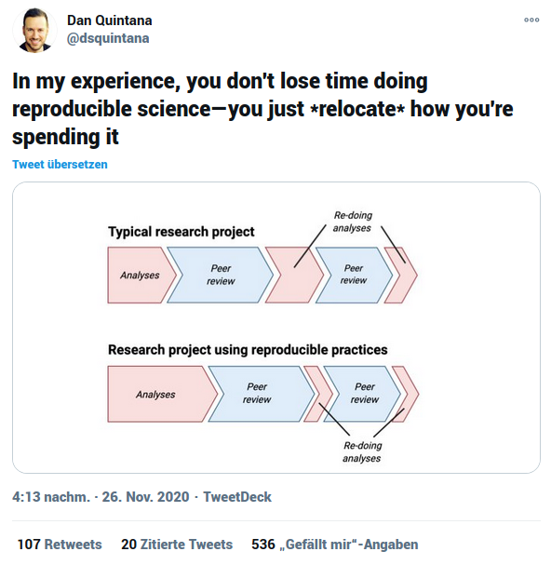
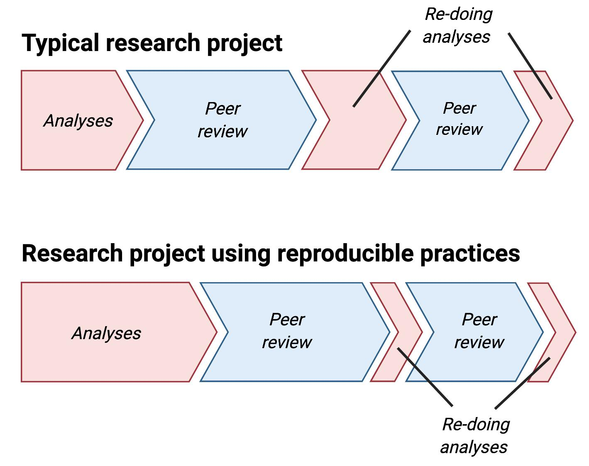
Quintana, D. S. (2020, November 28). Five things about open and reproducible science that every early career researcher should know. https://doi.org/10.17605/OSF.IO/DZTVQ
Notes:
And while better reproducibility to answer journal requirements might be the only way to introduce real change, let’s be clear that using reproducible practices is not something that you only do for you, but something that you can apply just for yourself! This is a recent tweet by Dan Quintana, who makes it clear that the extra time you might feel you have to spend in the beginning, really pays off later in the research process when you have to adjust you analysis, and even further down the road when you want to write your next paper.
Reproducibility is the basis for reusability and collaboration, and future you is your best collaborator.

Slide 26
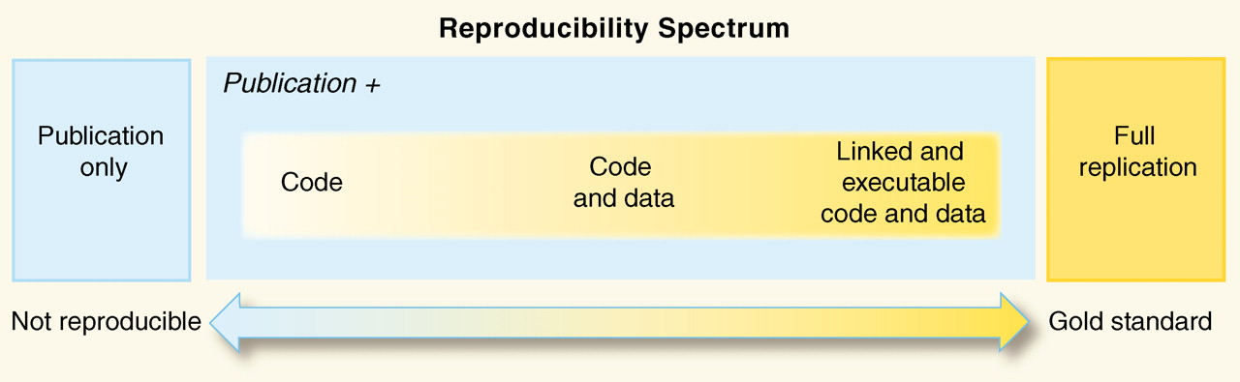
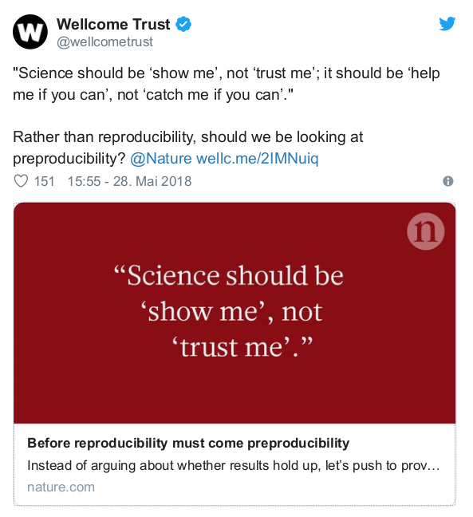
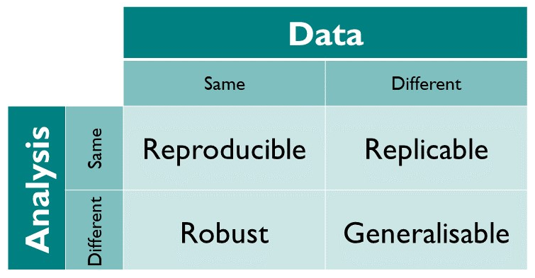

Reproducible Research & Open Science
https://doi.org/10.1126/science.1213847
Preproducibility
https://the-turing-way.netlify.app/reproducible-research/overview/overview-definitions.html
https://doi.org/10.1038/d41586-018-05256-0
Notes:
Reproducibility Spectrum by Roger Peng
------
Preproducibility ist ein Neologismus von Philip B. Stark als als Alternative zu den verwirrenden oder unterschiedlich interpretierten existierenden Begriffen, nämlich: "An experiment or analysis is preproducible if it has been described in adequate detail for others to undertake it. Preproducibility is a prerequisite for reproducibility, and the idea makes sense across disciplines. [...] Science should be ‘show me’, not ‘trust me’; it should be ‘help me if you can’, not ‘catch me if you can’." Lesenswert: 10.1038/d41586-018-05256-0 !

Slide 27
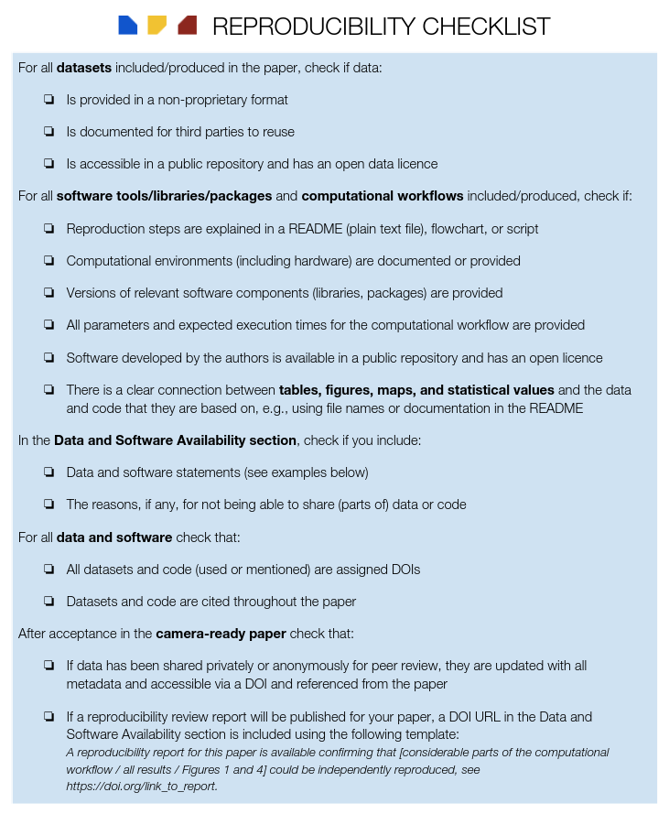
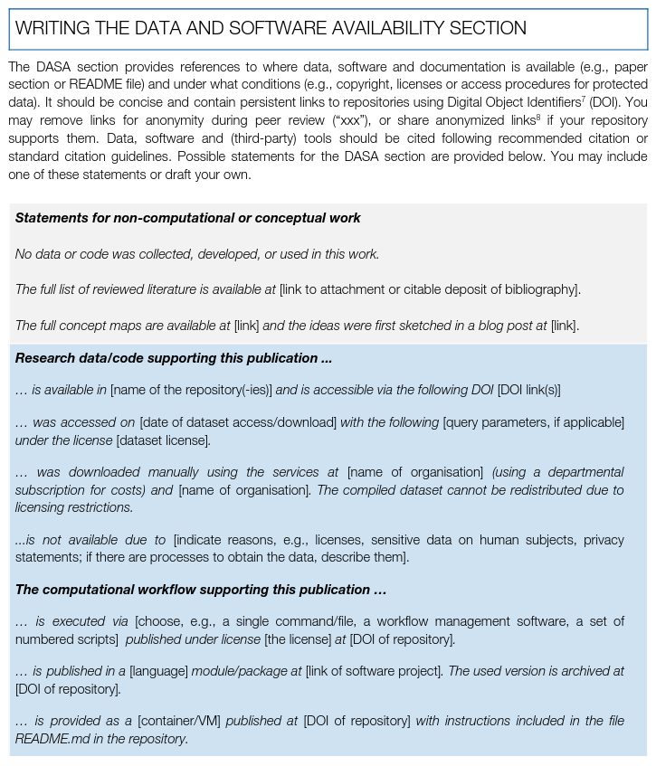
Checklist and writing the DASA section
https://doi.org/10.17605/OSF.IO/CB7Z8
Notes:
The bare minimum for authors to look at and know!

Slide 28
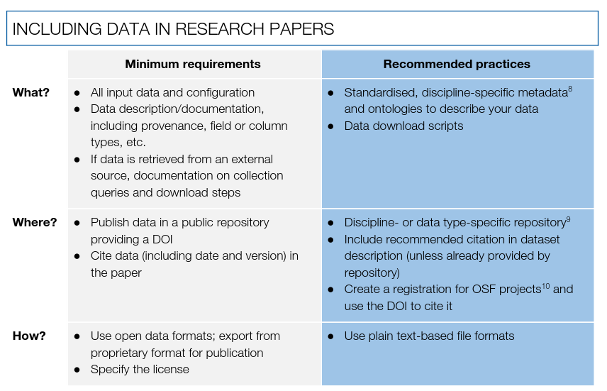
The guidelines for data
“What if…” and
Examples not shown
https://doi.org/10.17605/OSF.IO/CB7Z8
Notes:
Here are the guidelines for data in a nutshell: Data must be (a) published (b) in a data repository (DOI) and (c) using open data formats.
Ideally the provided metadata and the used repository are discipline specific (e.g., PANGAEA for measurement data) and FAIR guidelines are followed.
The guidelines also include a few “What if…” statements to answer commonly faces concerns and questions of authors, and some examples, with more examles in the Wiki.

Slide 29
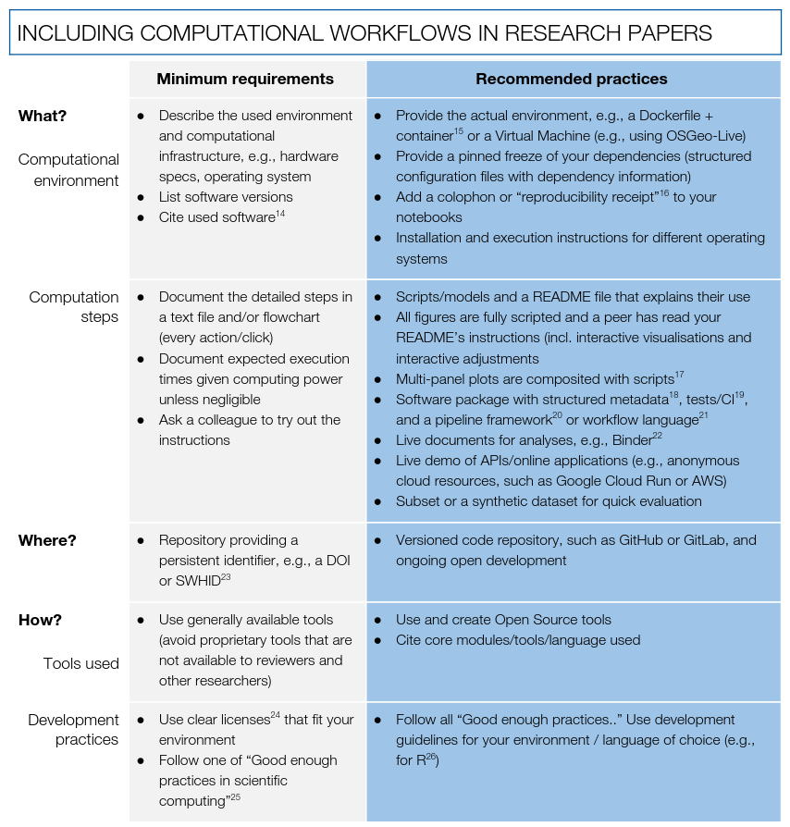
The guidelines for computational workflows
https://doi.org/10.17605/OSF.IO/CB7Z8
Notes:
Here are the guidelines for workflows:
Minimum boils down to having a README that describes the generally available software and hardware used, with files published with a DOI.
Intermediate adds some structure and requires a scripted workflows.
Ideal increases the requirements on the environment (e.g., container, VM), structured metadata, code repository (open development, not just snapshot), open source tools, proper software citations, and good software practices.
The guidelines also include a examples, with more examples in the Wiki.

Slide 30
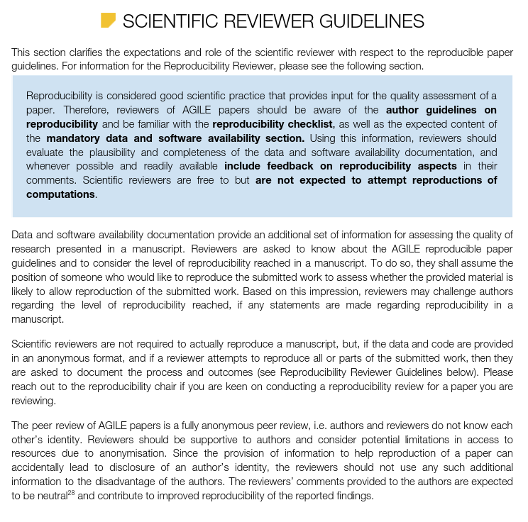
Scientific reviewer guidelines… concerning the reproducibility review only!
https://doi.org/10.17605/OSF.IO/CB7Z8
Notes:
Here are the guidelines for workflows:
Minimum boils down to having a README that describes the generally available software and hardware used, with files published with a DOI.
Intermediate adds some structure and requires a scripted workflows.
Ideal increases the requirements on the environment (e.g., container, VM), structured metadata, code repository (open development, not just snapshot), open source tools, proper software citations, and good software practices.
The guidelines also include a examples, with more examples in the Wiki.

Slide 31
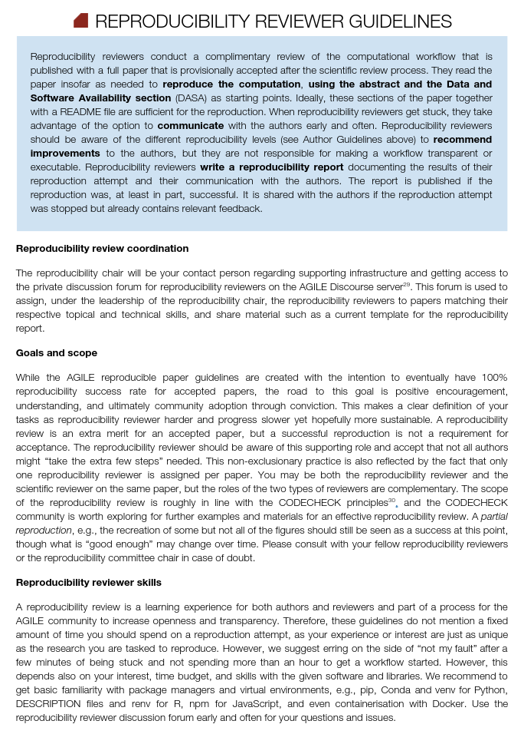
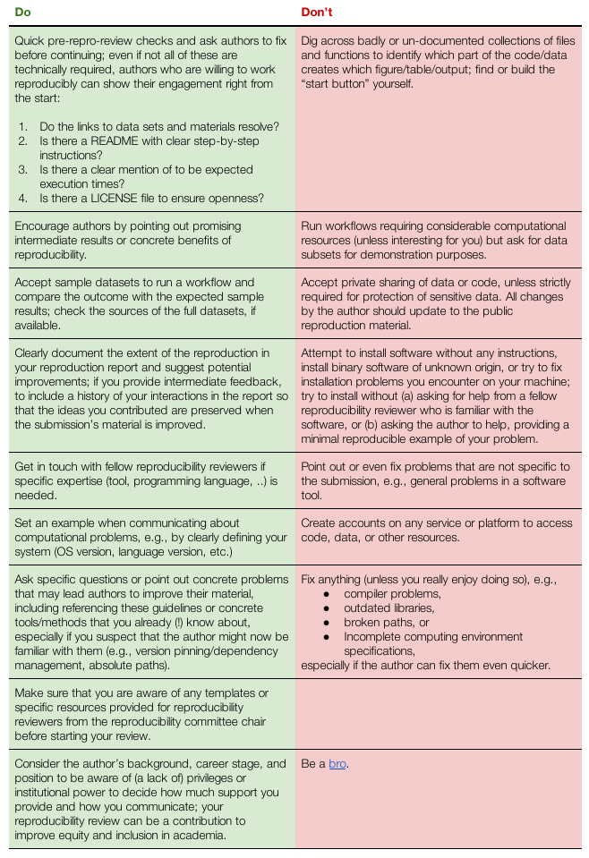
The guidelines for reproducibility reviewers
Ideal vs. realistic
Role & skills
Examples for “Do’s and Don’ts”:
Do shift burden to author
Do encourage and set examples
Do not accept private data sharing
Document your work in report (impact)
Be kind (career stage, knowledge, privileges)
No rummaging
Notes:
Here are some examples for things to do and not to do.
We want to shift the main burden to the author;
Reviewers are very welcome to encourage and share their knowledge;
Reviewers should not accept private sharing of data without very good reason;
The reproducibility review is a contribution to science, that is why the recommendations and feedback should be documented and is published in a document with a DOI.
The reviewers are encouraged to acknowledge the challenges that individual authors might face, for example disadvantages they have, and be kind.
So far, that was not a problem at all, of course, but it hopefully encourages more authors to be open and transparent.
The hardest task in my experience is ”no rummaging”: it is really hard not to get excited and dig deeper all the time feeling “I am so close” !

Slide 32
General observations and lessons learned (2021!)
Further improvement over last years submissions - better prepared workflows! Biggest hurdles remain: insufficient documentation, no “quick” variant or lack of expected data size/runtime, links Figures < > Scripts
Community understanding better, but needs time: Had to remind authors to add DASA section - how can we be clearer in the communication? Camera-ready papers by authors possible, but exhausting.
Additional reproducibility questions for scientific reviewers worked better, but triggering only by regular reviewers doesn’t work well - fortunately not too many submission to check for repro chair
Repro reviews were less strict than original ideal but on par with last year
> promote positive examples and don’t expect perfection
Non-blindness served its purpose, but unblinding also delayed procedures
Schedule still very much a challenge, partly because infrastructure (EasyChair) does not enable reviewer roles and communication > working around that with scripts and scraping
Improvements to process were good: clarity in communication for authors that DASA section is mandatory, not attempting short papers, do not offer authors to object to report publications (no problems!)
Reproduction not attempted != bad science, reproducibility is not binary but a spectrum
> continue education on reproducibility, increase requirements while practices spread in community

Slide 33
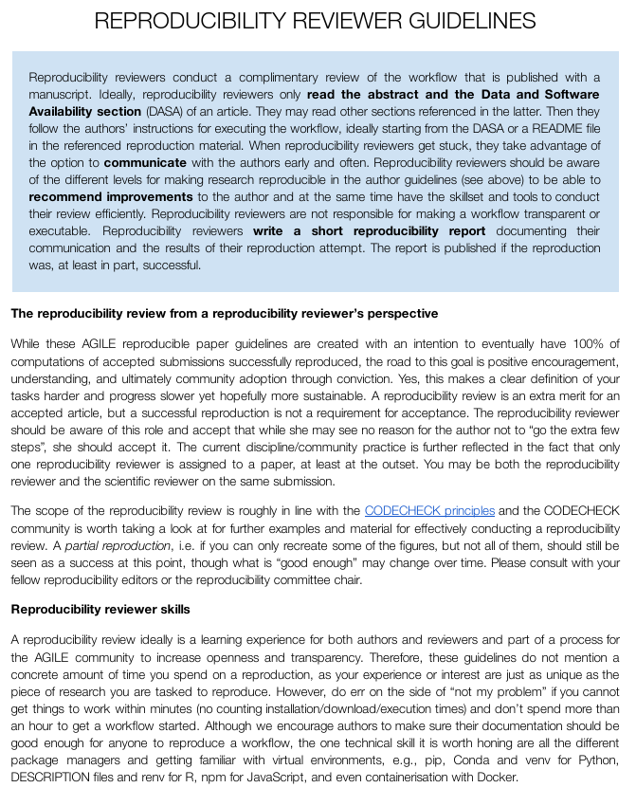
The guidelines for reproducibility reviewers
Ideal vs. realistic
Role
Skills
Do’s & dont’s
Notes:
[4:00]
I will skip the details of the author guidelines, but I’d like to take a look at the brand new reproducibility reviewer guidelines, because they really set the tone and scope of how we do reproducibility reviews. Your feedback would be much appreciated and a link to the draft document is at the bottom of this slide.
We try to be transparent about the ideal steps and more realistic steps a reproducibility reviewer might take.
Ideal is if the reproducibility reviewer reads the abstract and DASA section, follows instructions in the README to reproduce the computations, and then writes the report.
More realistic however is: read abstract and DASA section, skim methods section, identify computer-generated figures and tables, follow all links in DASA section, start reproduction by trying to connect figures with the respective code or scripts, communicate with author, retry reproduction, improve the documentation of the computing environment, finish partial reproduction, write report with many recommendations what authors could improve, then be done.
The role is set out to be critical reviewer, but in part also educator. Reviewers should encourage and motivate, but not fix any problems. We accept irreproducibility if the author is not interested in making it work.
Regarding reproducibility reviewer skills, we see familiarity with package managers and virtual environments as crucial; while anyone should be able to reproduce any workflow with enough time and good enough documentation, we recommend to ask the author for help if one cannot get started within minutes, and stop if getting a workflow to run takes longer than one hour.
The section ends with a table of “Do’s and Don’ts” of reproducibility reviewer behaviour. Here are some examples:
Do not fix bugs.
Do encourage and share your knowledge by giving feedback.
Do document provided feedback in the reproducibility report to ensure traceability of your scientific contribution as a reviewer.
Do acknowledge the challenges that individual authors might face, for example structural, institutional or personal disadvantages.
And finall,y the hardest “don’t” in my experience: ”no rummaging”. It is really hard not to get excited and dig deeper all the time feeling “I am so close to get this to work” !

Slide 34
🙌
How to put your community on a path towards
more reproducibility in 5 easy hard steps
Build a team of enthusiasts (workshop, social events)
Assess the current state and raise awareness (workshop, paper)
Institutional support (🙏 AGILE Council 🙏 + committee chairs)
Positive encouragement (no reproduction != bad science)
Keep at it!
Notes:
In just three years, we were able to plant the seed of cultural and structural change (if I myself may say so). So here is how to put your community on a path towards more reproducibility in 5 easy steps:
Build a team of enthusiasts, for example by organising a workshop
Assess the current state and talk about it - this is how people will realise you are serious; in our case it was pre-conference workshops and a paper with a strong message
Try to get institutional support - in our case the support of the AGILE Council and the conference committee chairs made everything possible
Try to get the community on your side by staying positive and inclusive - irreproducibility is usually not a sign for bad science, but for a lack of knowledge and incentives, which you can try to create
Keep at it, cultural change takes time - putting reproducibility on the map is an achievement in itself, and every little step counts; providing feedback as part of the reproducibility reviews will, one author at a time, educate your community.

